Slide 1
Longitudinal Motion 2
Eric Prebys, FNAL

Slide 2
RF Manipulations
As you’ll show in homework, the synchrotron tune (longitudinal oscillations/turn) is generally <<1.
That means that if there are multiple RF cavities around the ring, the orbiting particle will see the vector sum of the cavities.
We will clearly get the maximum energy gain if all phases are the same, so (assuming all voltages are the same)
RF1
RF2
RF3
RF3
φ_{i} is the phase angle at the arrival of the particle at cavity i

Slide 3
Do we always want the maximum acceleration?
As we’ll see, there are times when we want to change the amplitude of the RF quickly.
Because cavities represent stored energy, changing their amplitude quickly can be difficult.
Much quicker to change phase
Standard technique is to divide RF cavities into two groups and adjust the relative phase. In the simplest case, we put half the RF cavities into group “A” and half into group “B”. We can adjust the phases of these cavities relative to our nominal synchronous phase as
So
Like “turning RF off”

Slide 4
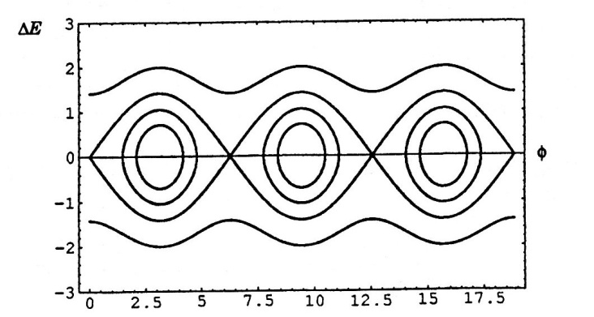
RF capture
We can capture beam by increasing the RF voltage with no accelerating phase
As we accelerate beam, Δt decreases. Recall
So as beam accelerates, bunches get narrower

Slide 5
Bucket to Bucket Transfer
In general, the accelerating gradient of an RF structure is
So when bunches get short enough, it’s advantageous to transfer to a higher frequency. For example, in the Fermilab Linac
200 MHz Linac
800 MHz Linac
Transfer beam to every 4th bucket

Slide 6
Bunch Rotation
If we slowly change the RF voltage (or effective voltage by phasing), we can adiabatically change the bunch shape
If we suddenly change the voltage, then the bunch will be mismatched and will rotate in longitudinal phase space

